Slide 1







Dynamic Forms
Survey, Inspection and General Purposes
On-The-Fly Launch GIS Enabled Mobile Application using Dynamic Forms
Ease of Use: Department’s admin Or business user can create their own custom forms. No dependencies on code/development/build. Usage could be for Survey, Inspection, Data Collection, Questionnaire or General Purpose.
Workflow: Parakh Survey and Inspection forms are equipped with a workflow. The Admin can “initiate & assign” a survey, inspection, or initiate a general form.
Reach: Enables “Citizens” and “Age ncies” to fill out the forms.
Solution: Versatile solution designed for both Mobile and Web.
Quick to Launch: Create a form using UI interface(web) and launch it on Mobile.
Few Implementations:
Ujjain Auto Mela - Vehicle Dispatch & Sale
Borewell Management System for PHE
Farm Survey for Beej Nigam
Site Inspection App for Alirajpur Collectorate
14 Inspection forms for Labour Department
Survey Of India to conduct geographical survey

Slide 2
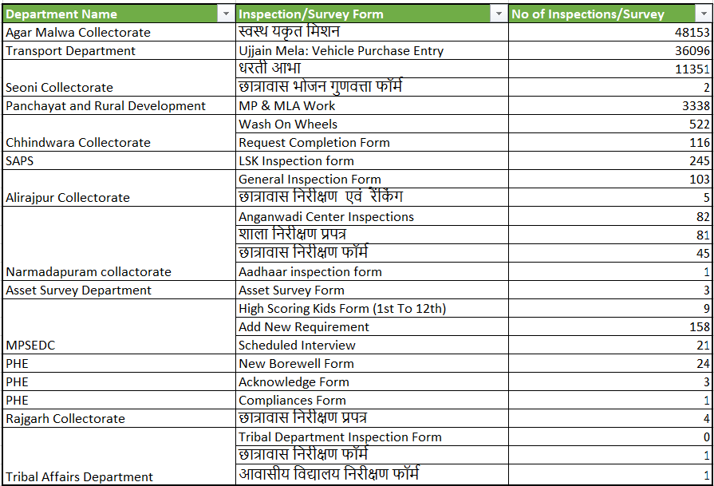
Parakh Data Usage
Registered Departments All Form Record Statistics & No of Inspection and Survey conducted

Slide 3
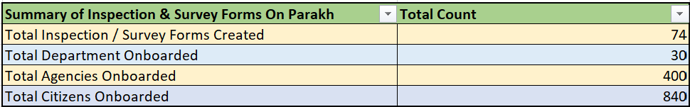
Parakh Data Usage
Summary of Inspection & Survey Forms On Parakh
Note: Above Total Inspection/Survey Form & their Count

Slide 4


Reach Out to
MPSEDC Ltd. State IT Centre, 47-A, Arera Hills, Bhopal-462011 (M.P.)
Thank You
CONTACT
+91 755 2518300, +91 755 2518500
mpssdi@mp.gov.in

